Slide 1



TECH SCAPE
ILLUSTRATION

Slide 2

APPLE ENTERPRISE
Apple’s industry of mobiles, mac, iwatch, ipad, imac, apple vision pro & counting.
Apple’s innovations that kept it at the peak, competing with brands like Samsung.
Apple innovates like Apple Vision Pro, M1/M2 chips, MagSafe, Spatial Audio
Apple’s Infrastructure are incredible to show apple standalone.

Slide 3

PROBLEM STATEMENT
That we planned to show off the apple’s industry, innovation & infrastructure in a website.
That the site contains four navigations to explore 3 key topics. Finally Home pages intreprets our project.
TECHSCAPE

Slide 4

TECHNOLOGIES
We pulled the technogies to build this site,
HyperText Markup Language HTML
Cascading Style Sheets CSS
Bootstrap (CSS Library)
Tailwind(CSS Library)
Vercel for hosting.
GitHub for VCS.
Editor(VS Code)
TECHSCAPE

Slide 5



TEAM
JOEL.A
ABISHEK.D
Designer & Developer
Tech Enthusiast

Slide 6

MARKET OVERVIEW
2.2% increases
$3.59 Trillion
2%
Compared with 2024
Market Size
Year by Year
Techscape

Slide 7
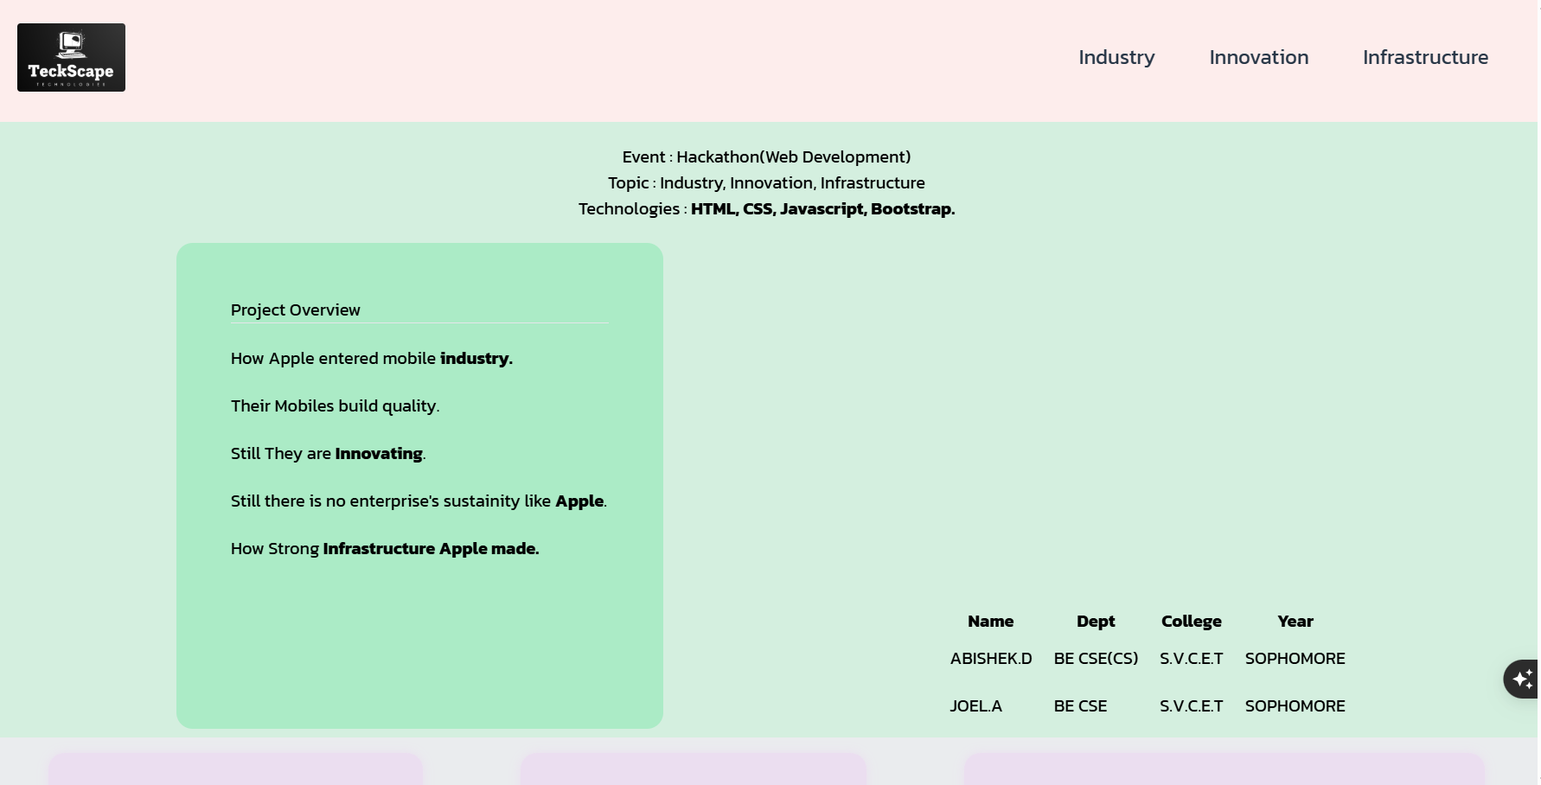
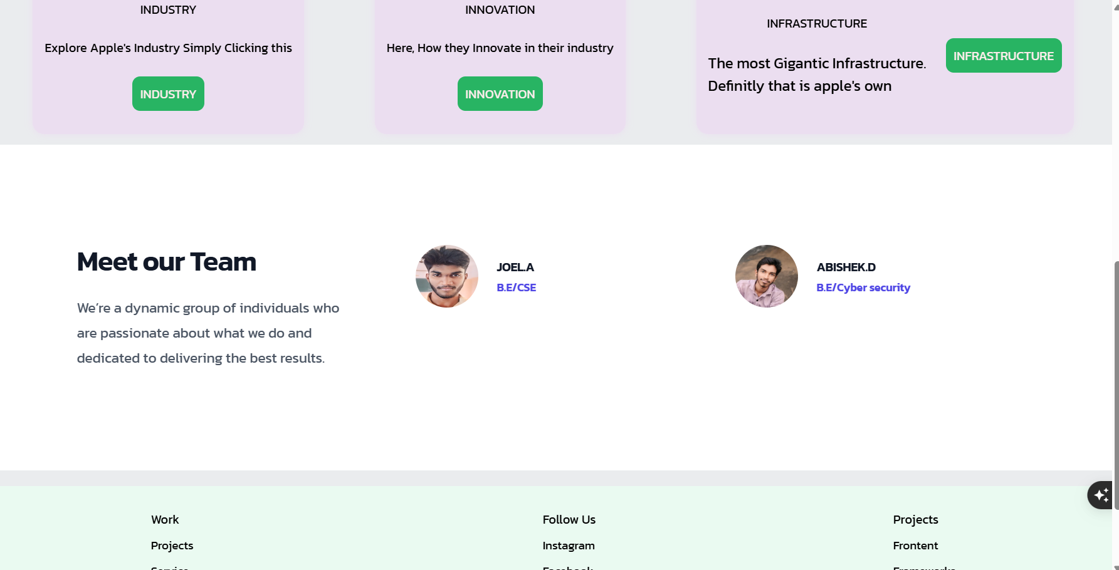
Home Page Website Preview

Slide 8
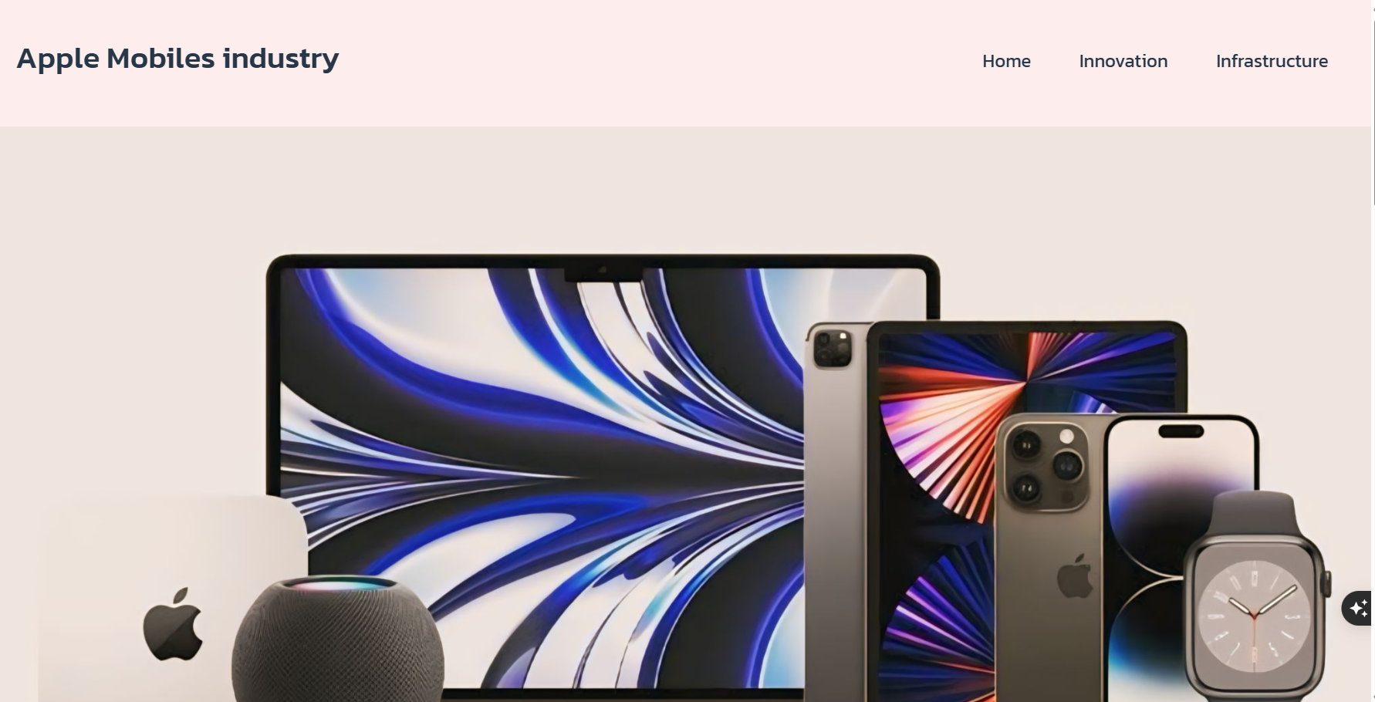
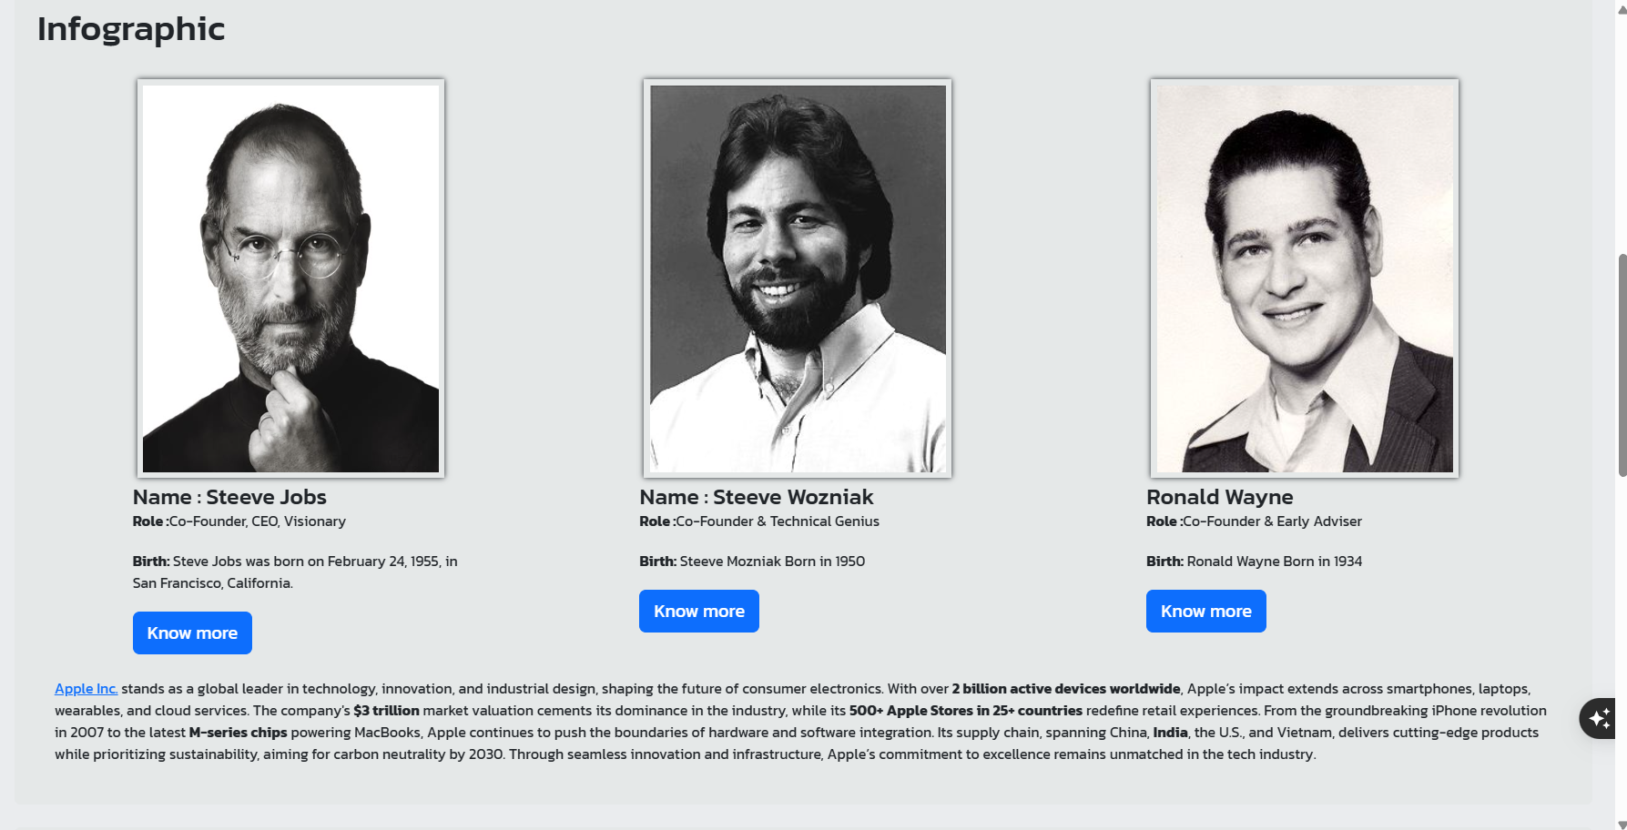
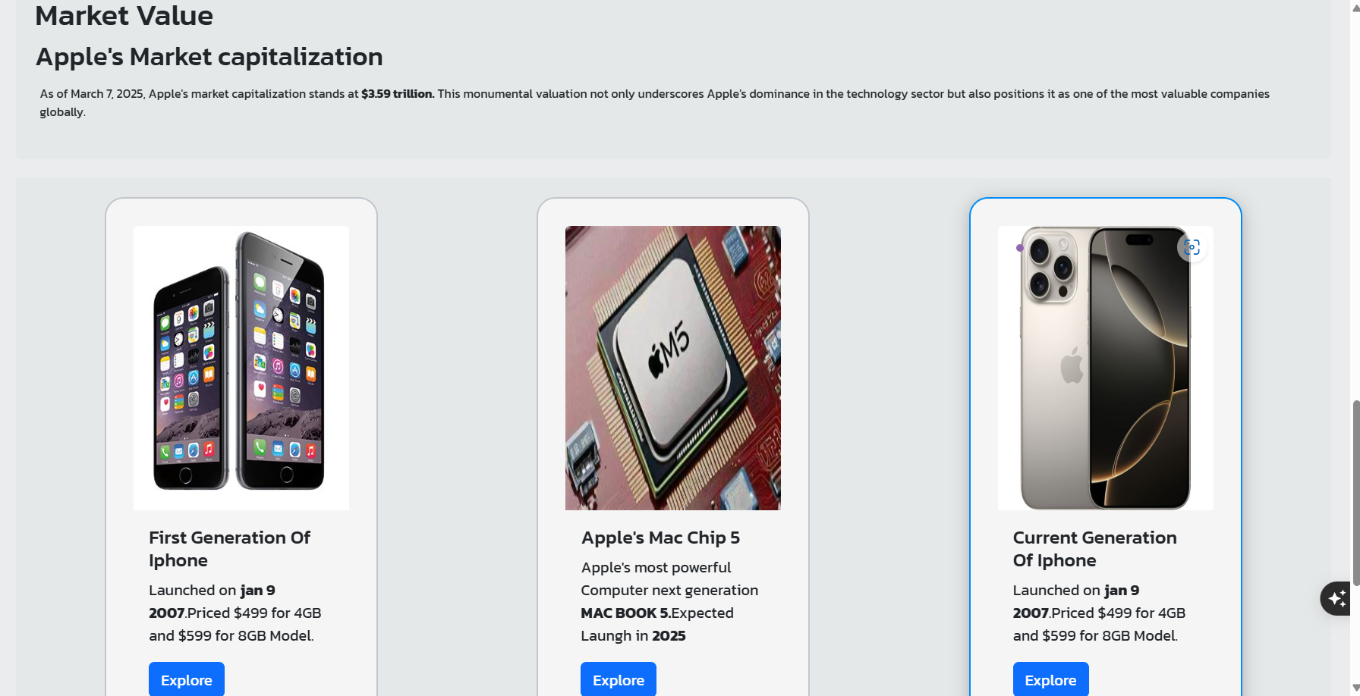
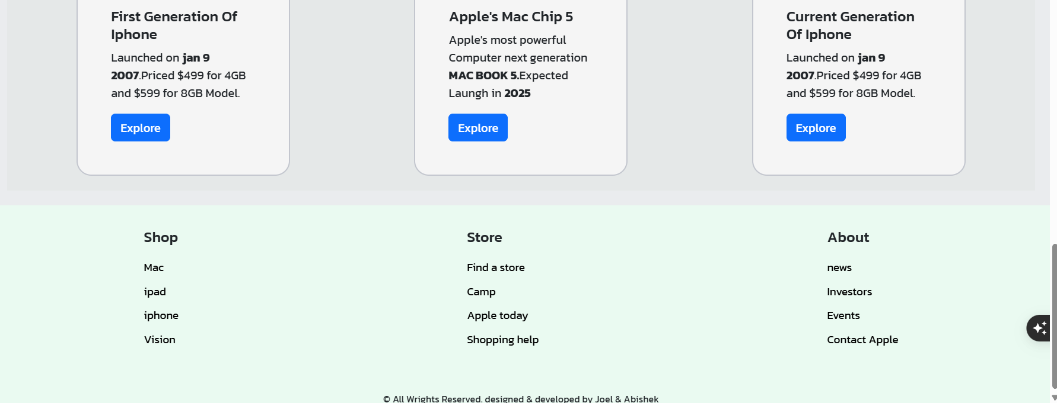
INDUSTRY PAGE PREIEW

Slide 9
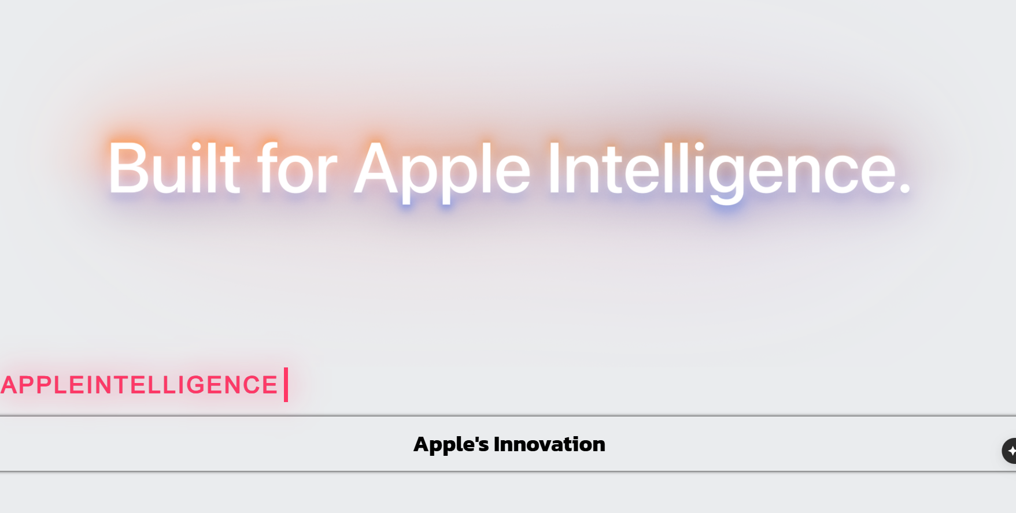
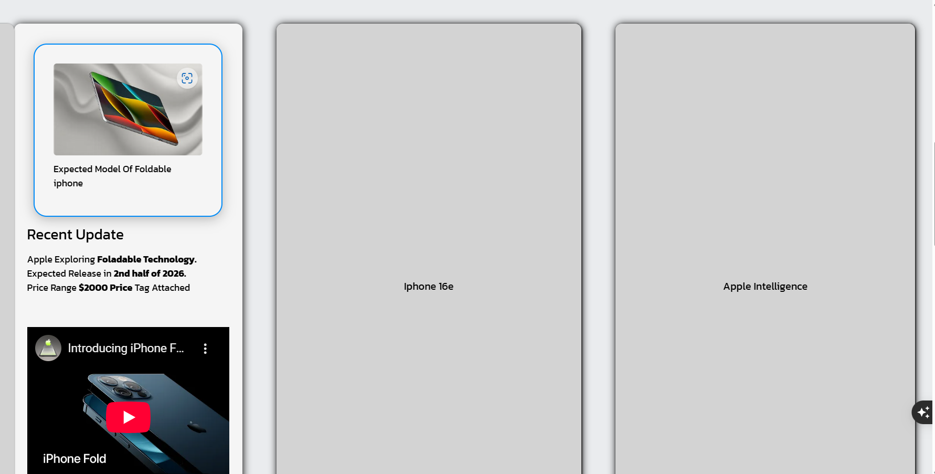
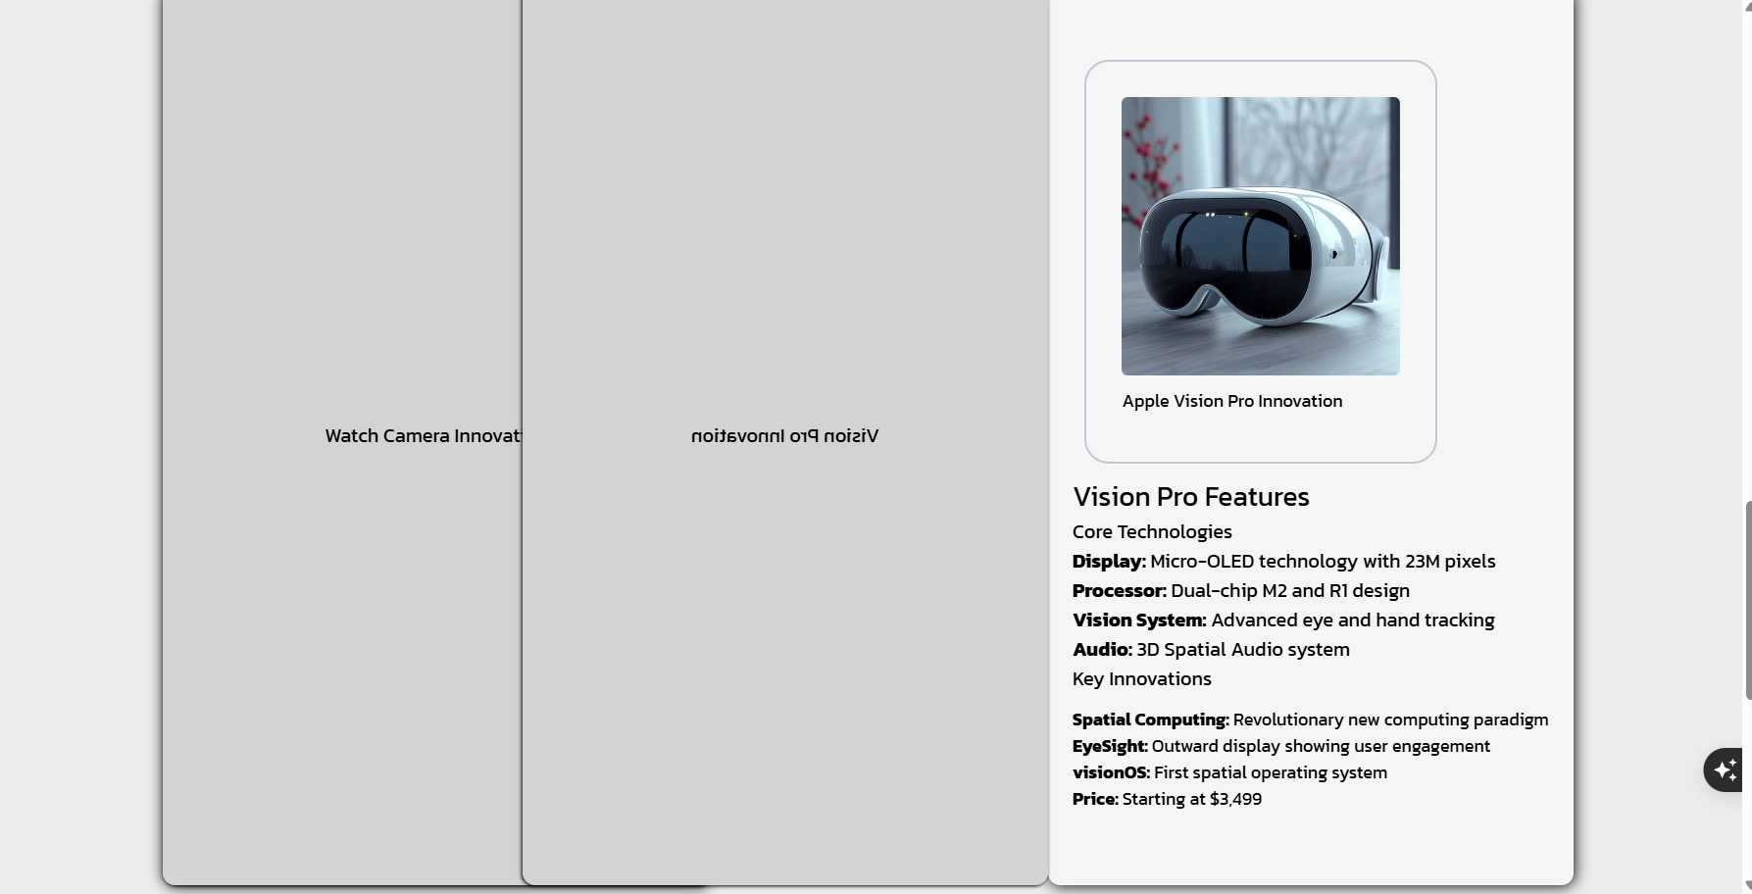
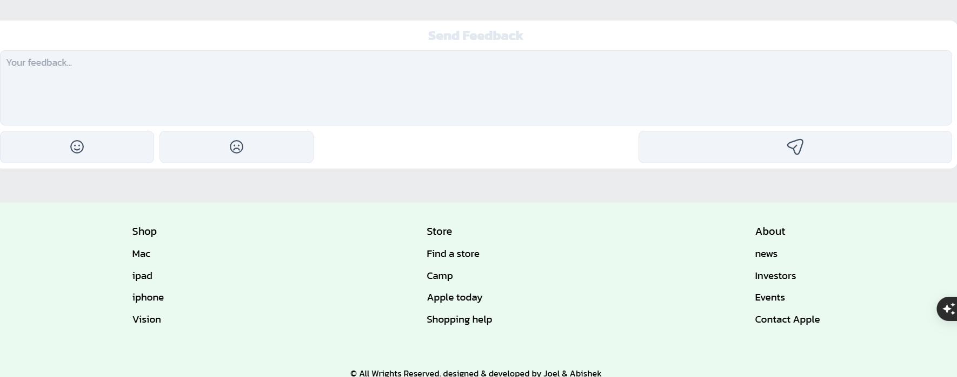
INNOVATION PAGE PREIEW

Slide 10
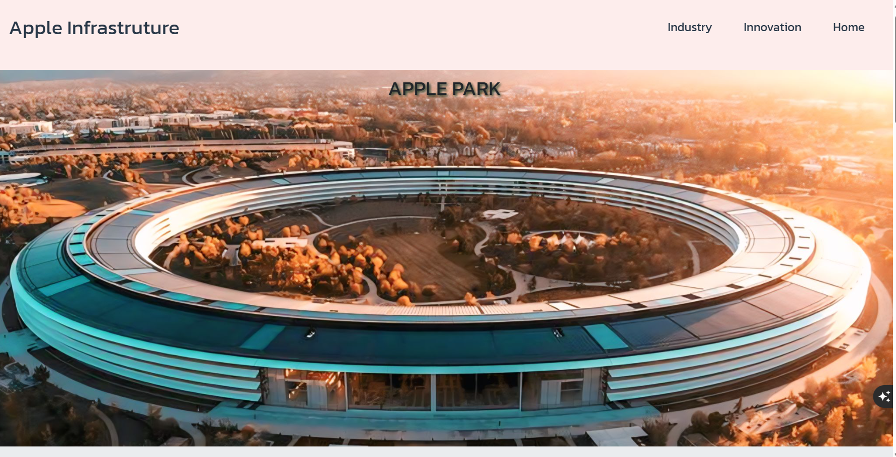
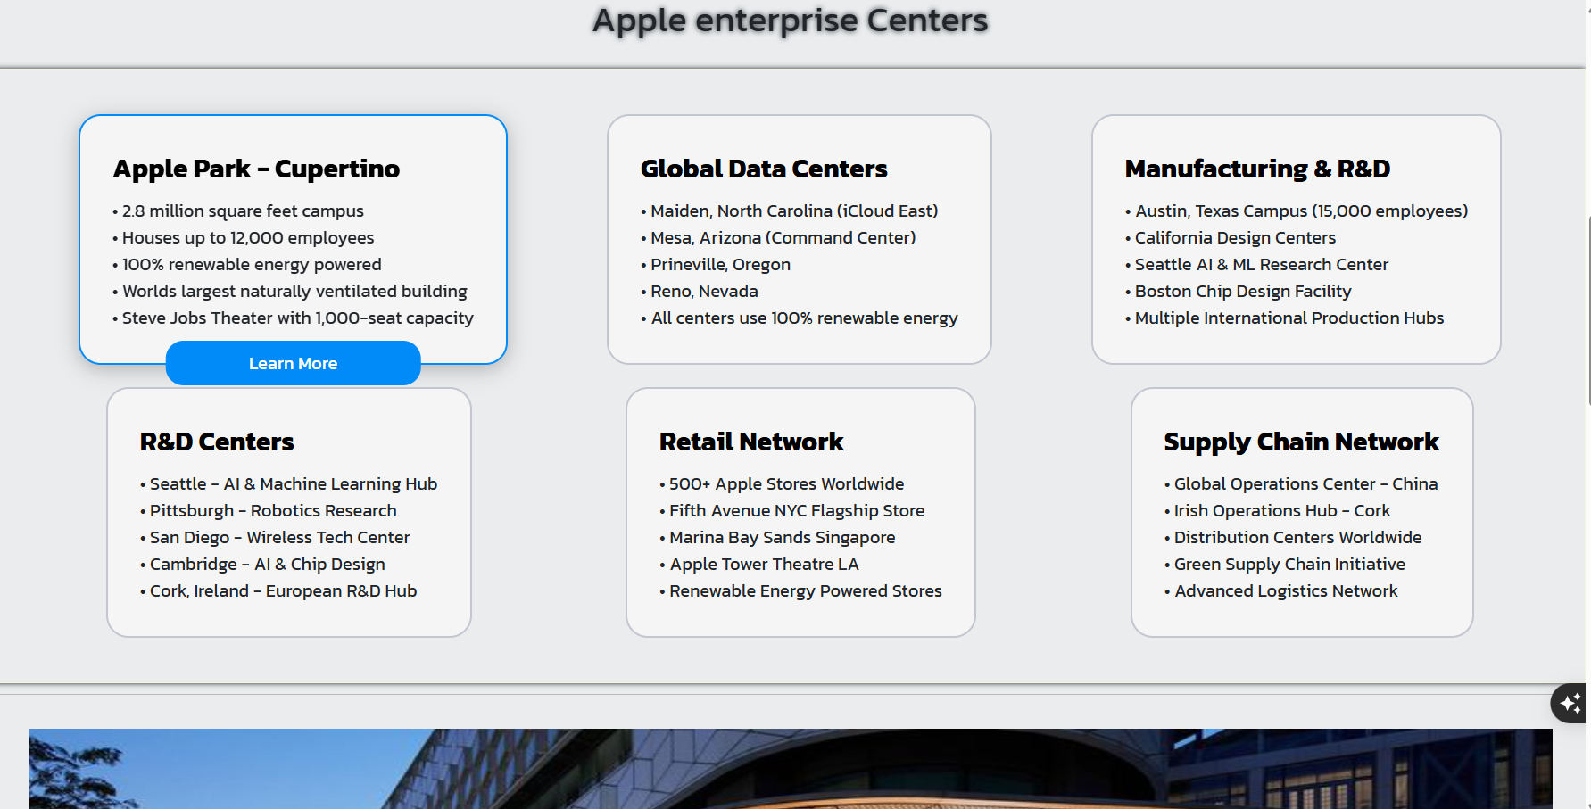
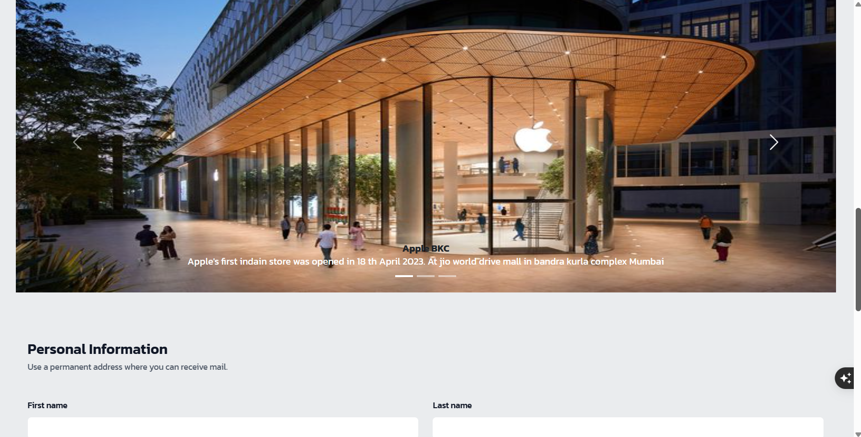
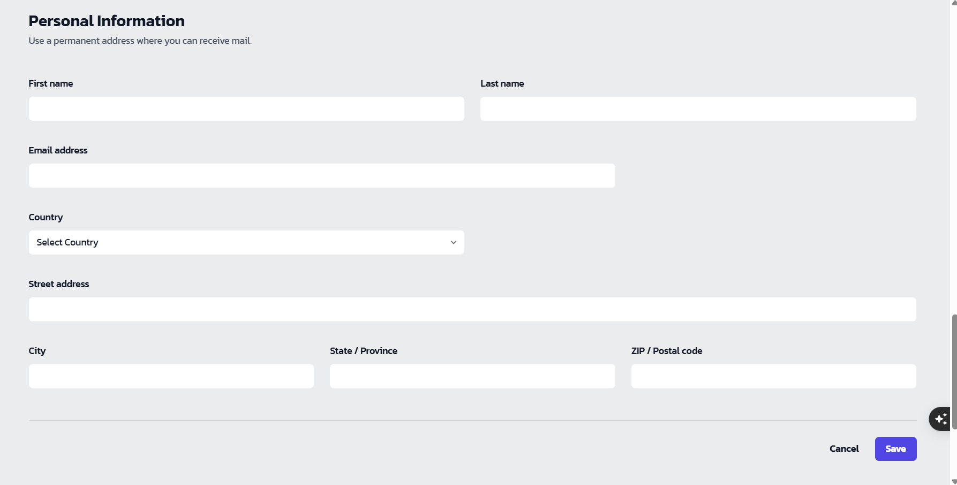
INNOVATION PAGE PREIEW

Slide 11

WHAT WE DID
We Orchestrated to build clean and interactive site that describe the power of apple’s Industry, Innovation & infrastructure.
Finally, we’re infront of you with all our works done. we’re Done.
Techscape

Slide 12
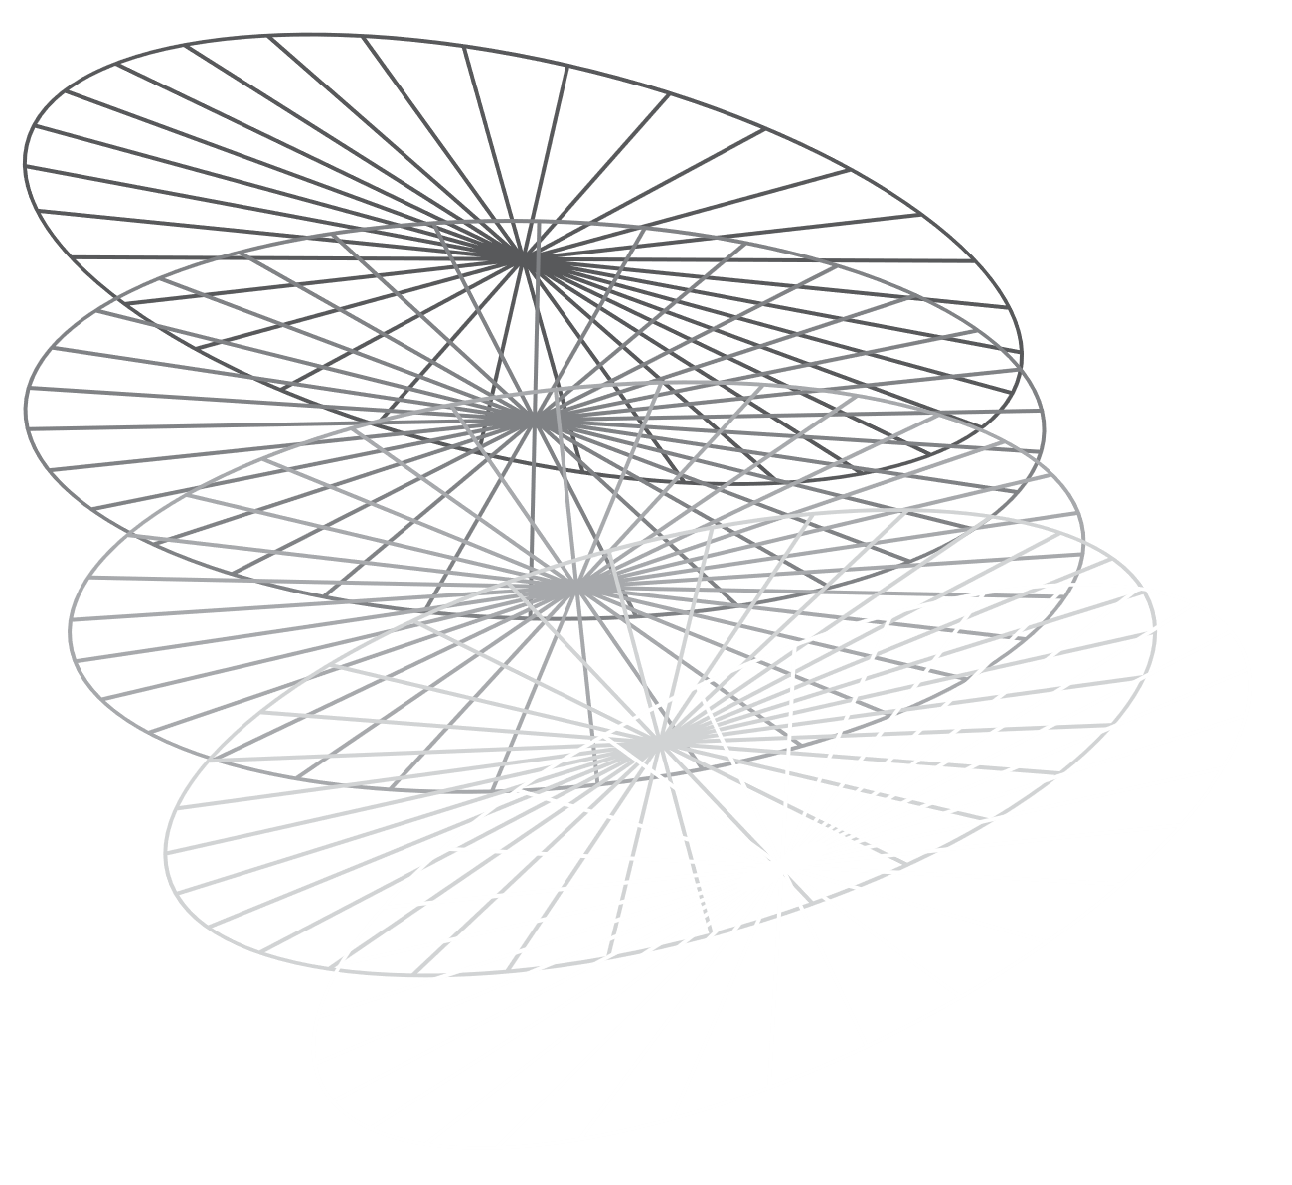
We are in the trajectory of build websites that empowers organizations to effectively integrate their data, decisions, and operations. Learning to be Continued…………….
Techscape

Slide 13
PROJECT DEMONSTRATION
Site Link
GitHub Repository
Vercel Host
Techscape

Slide 14
THANK YOU
TECH SCAPE

